Slide 1
Reinforcement Learning in CartPole Control
Yunhan Wang
Ziyi Yang
Qiaochu Zhang
University of Southern California

Slide 2
Content
Background
Methodology
Result & Discussion
Hyperparameter selection

Slide 3

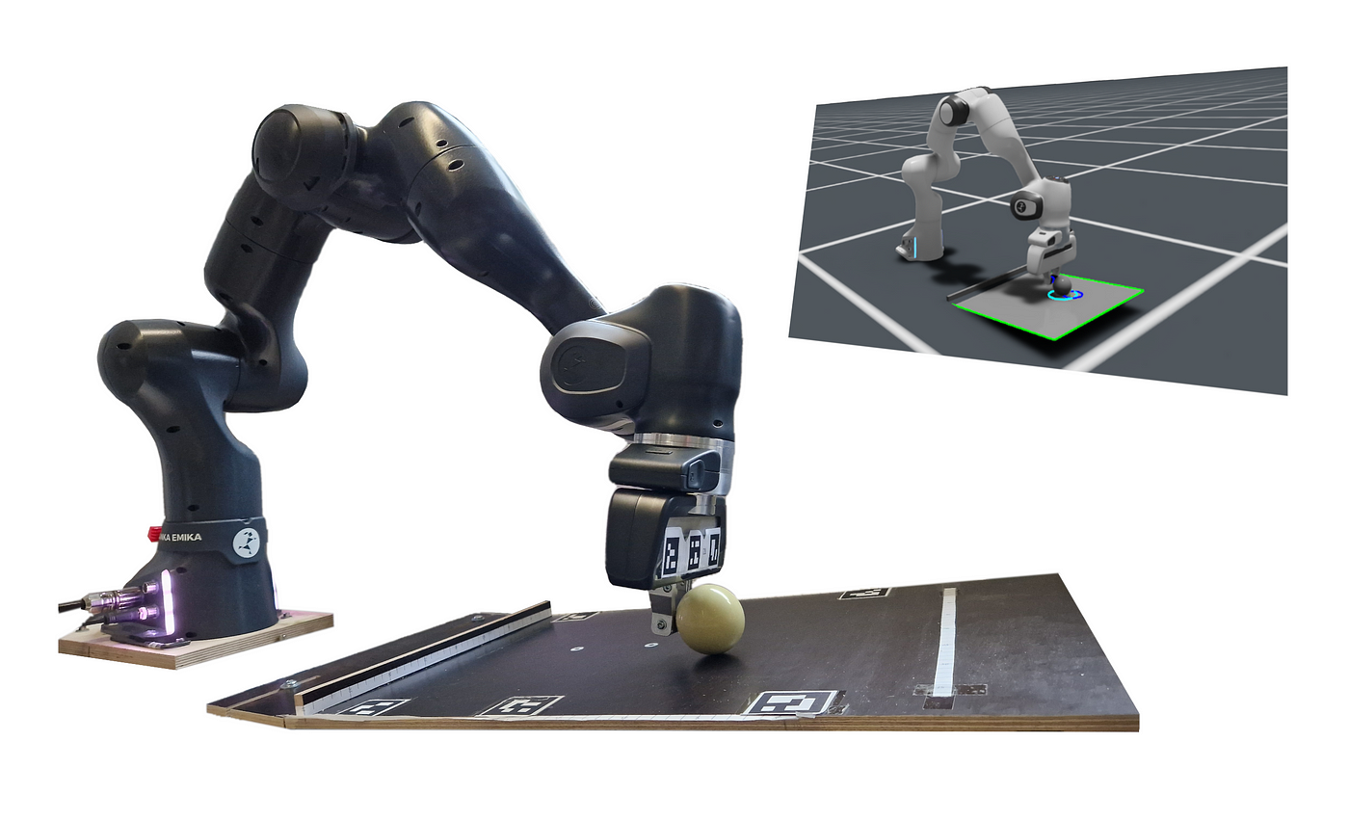
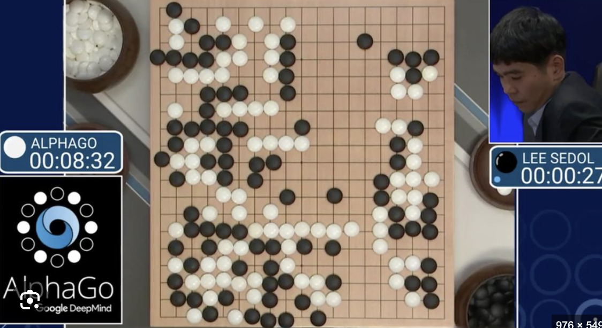
Background
Reinforcement Learning
What is RL?
Agent learns by trial and error through interaction with an environment
Feedback = reward signal rather than ground-truth labels
Goal: maximize expected cumulative return
Key building blocks
State s: observable description of the world
Action a: decision taken by the agent
Policy π(a∣s): mapping from states to action probabilities
Value / Q-function: long-term desirability of a state or (state, action)

Slide 4
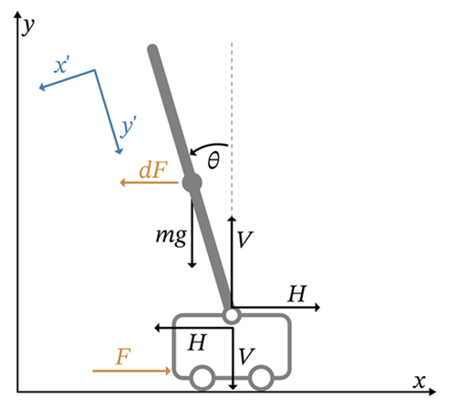
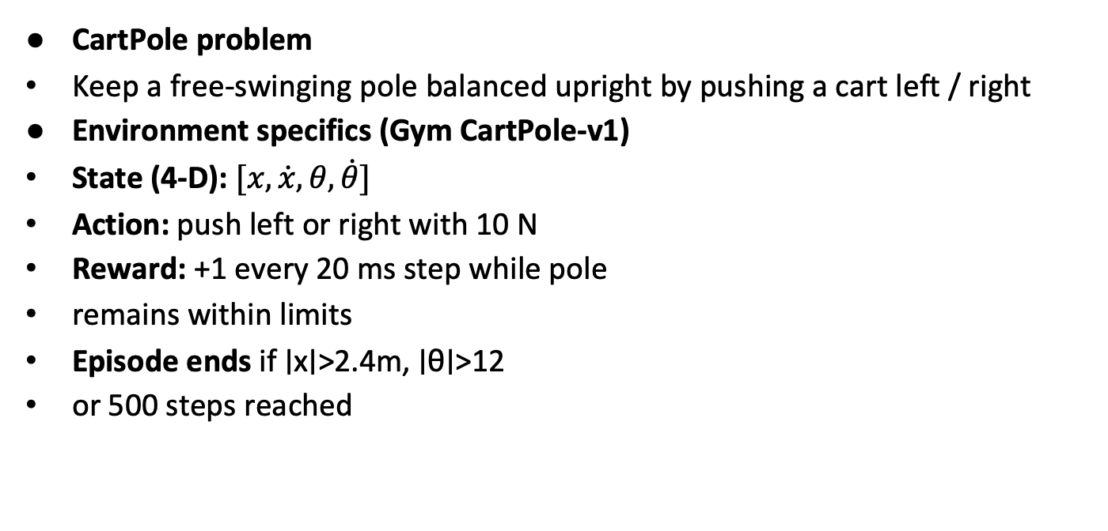
Background
CartPole problem
Keep a free-swinging pole balanced upright by pushing a cart left / right
Environment specifics (Gym CartPole-v1)
State (4-D): $[x, \dot{x}, θ, \dot{θ}]$
Action: push left or right with 10 N
Reward: +1 every 20 ms step while pole
remains within limits
Episode ends if ∣x∣>2.4m, ∣θ∣>12
or 500 steps reached

Slide 5
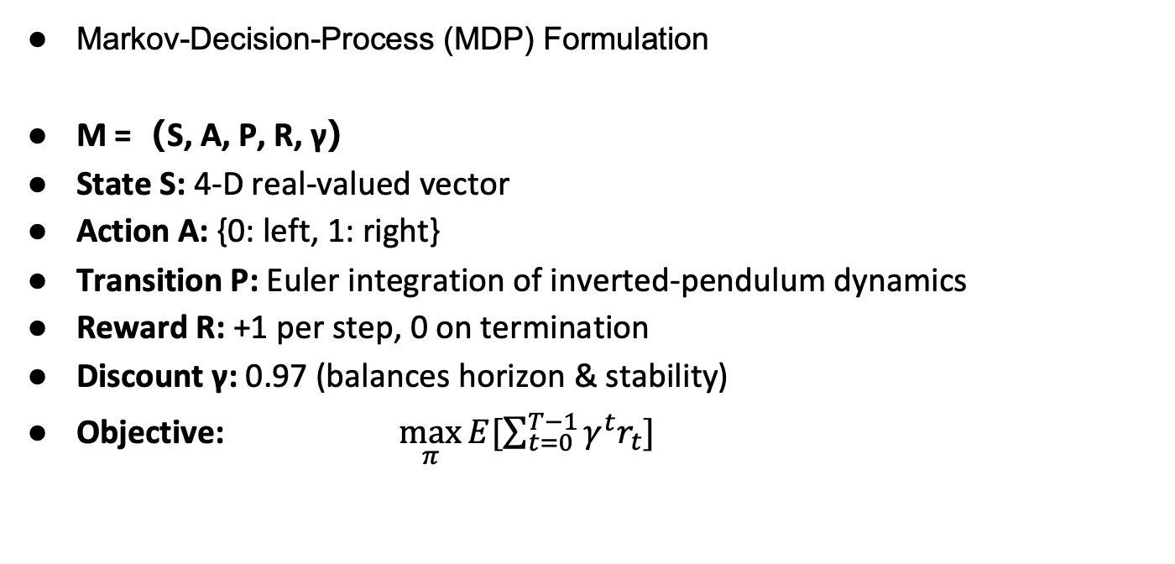
Methodology
Markov-Decision-Process (MDP) Formulation
M =（S, A, P, R, γ）
State S: 4-D real-valued vector
Action A: {0: left, 1: right}
Transition P: Euler integration of inverted-pendulum dynamics
Reward R: +1 per step, 0 on termination
Discount γ: 0.97 (balances horizon & stability)
Objective: $\max_{π}{E[\sum_{t=0}^{T−1}{γ^{t}r_{t}}]}$

Slide 6
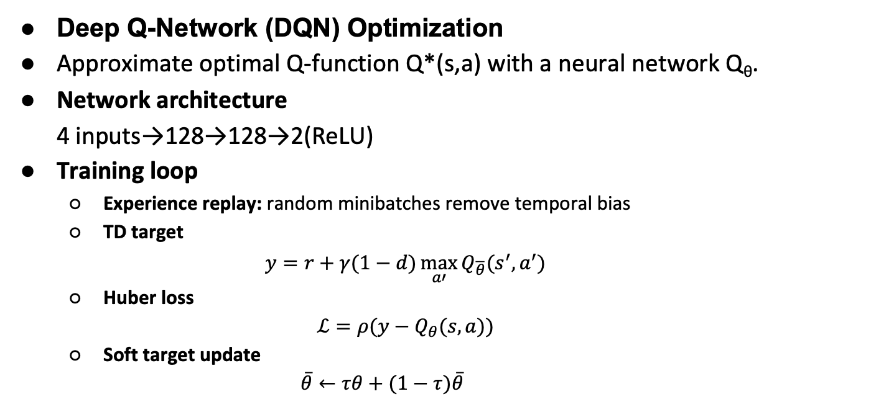
Methodology
Deep Q-Network (DQN) Optimization
Approximate optimal Q-function Q*(s,a) with a neural network Q_{θ}​.
Network architecture 4 inputs→128→128→2(ReLU)
Training loop
Experience replay: random minibatches remove temporal bias
TD target
$$y=r+γ(1−d)\max_{a′}{Q_{\overline{θ}}(s^{′},a^{′})}$$
Huber loss $ℒ=ρ(y−Q_{θ}(s,a))$
Soft target update
$$\overline{θ}←τθ+(1−τ)\overline{θ}$$

Slide 7
Methodology
ε-greedy exploration strategy
ε decays from 1.0 → 0.01 across training
Balances exploration early and exploitation later
Critical for avoiding premature convergence

Slide 8
Methodology
Problem: Instability and Wasted Training
TD error fluctuated wildly → hard to converge
Training continued even after convergence
No reward clipping → extreme values dominated updates

Slide 9
Methodology
Solution: Reward Pruning & Training Control
Clip reward to [−1, 1] → stabilize learning
Early stopping if avg(100 episodes) ≥ 195
Save model when avg(50 episodes) exceeds best-so-far

Slide 10
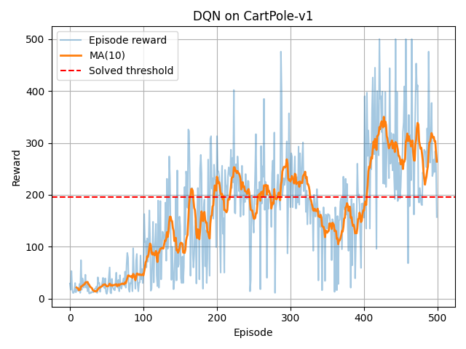
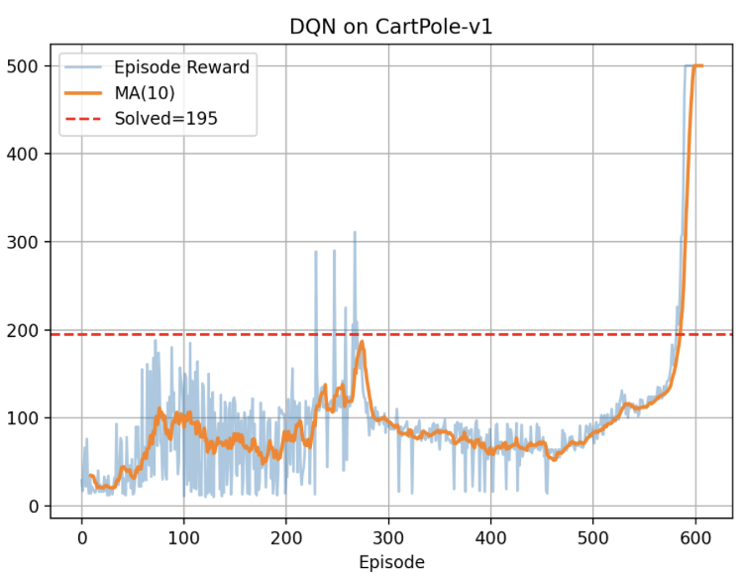
Result & Discussion
Before
After

Slide 11
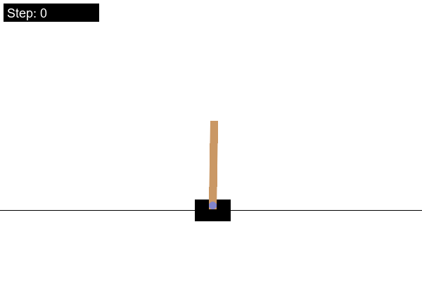
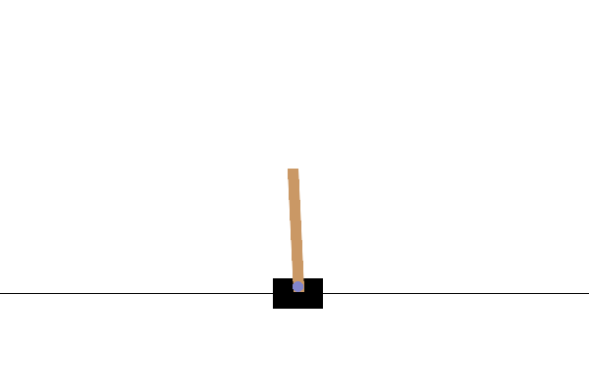
Result & Discussion
Before
After

Slide 12
Result & Discussion
What worked:
Reward clipping stabilized TD error
Early stopping saved training time
Checkpointing preserved best policy
ε decay allowed effective exploration
What didn’t work (before):
Hard target updates led to divergence
Lack of reward pruning caused instability
No logging made debugging difficult

Slide 13
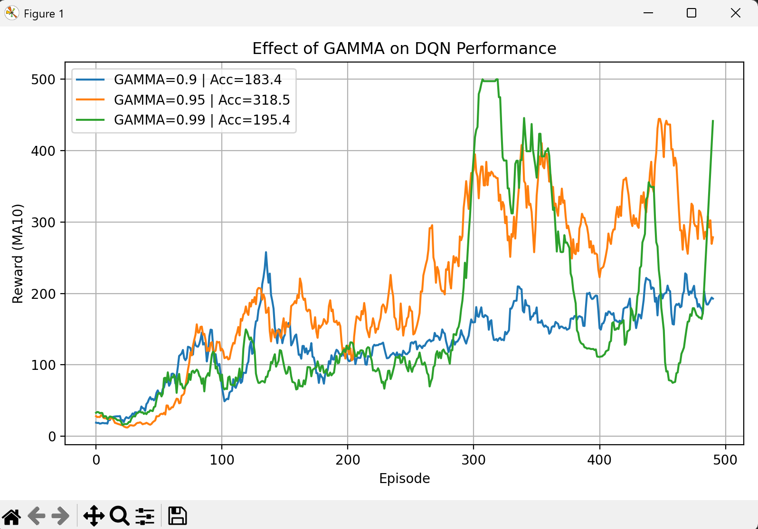
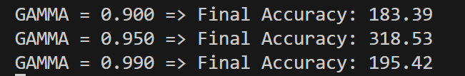
Hyperparameter selection
Gamma
Reason for choosing the value
Experimental objective
Summary for choosing GAMMA = 0.95

Slide 14
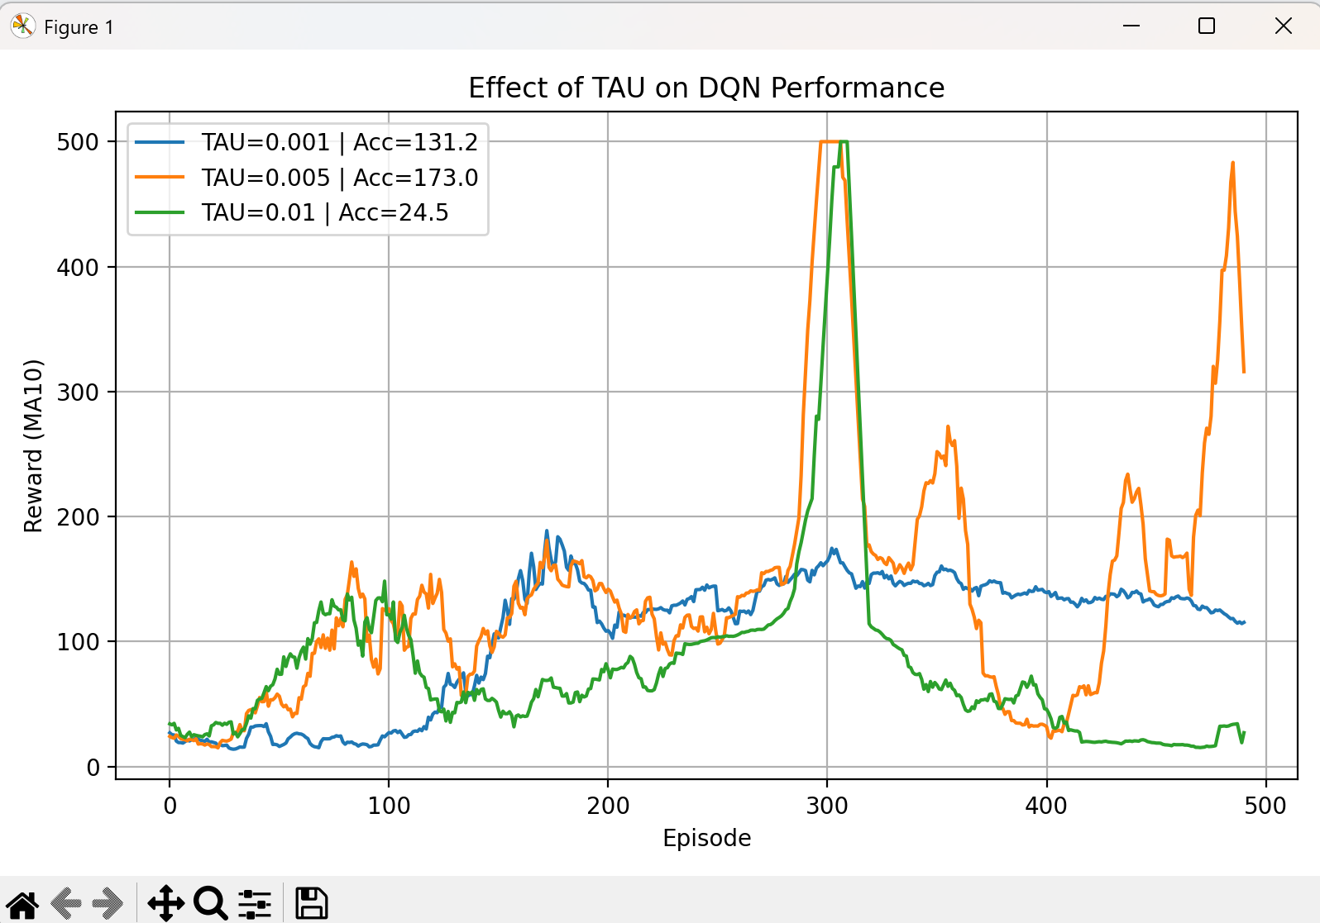
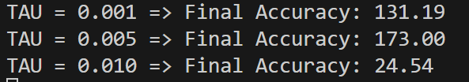
Hyperparameter selection
TAU (Soft Target Update Rate)
Reason for choosing the value
Experimental objective
Summary for choosing TAU = 0.005

Slide 15
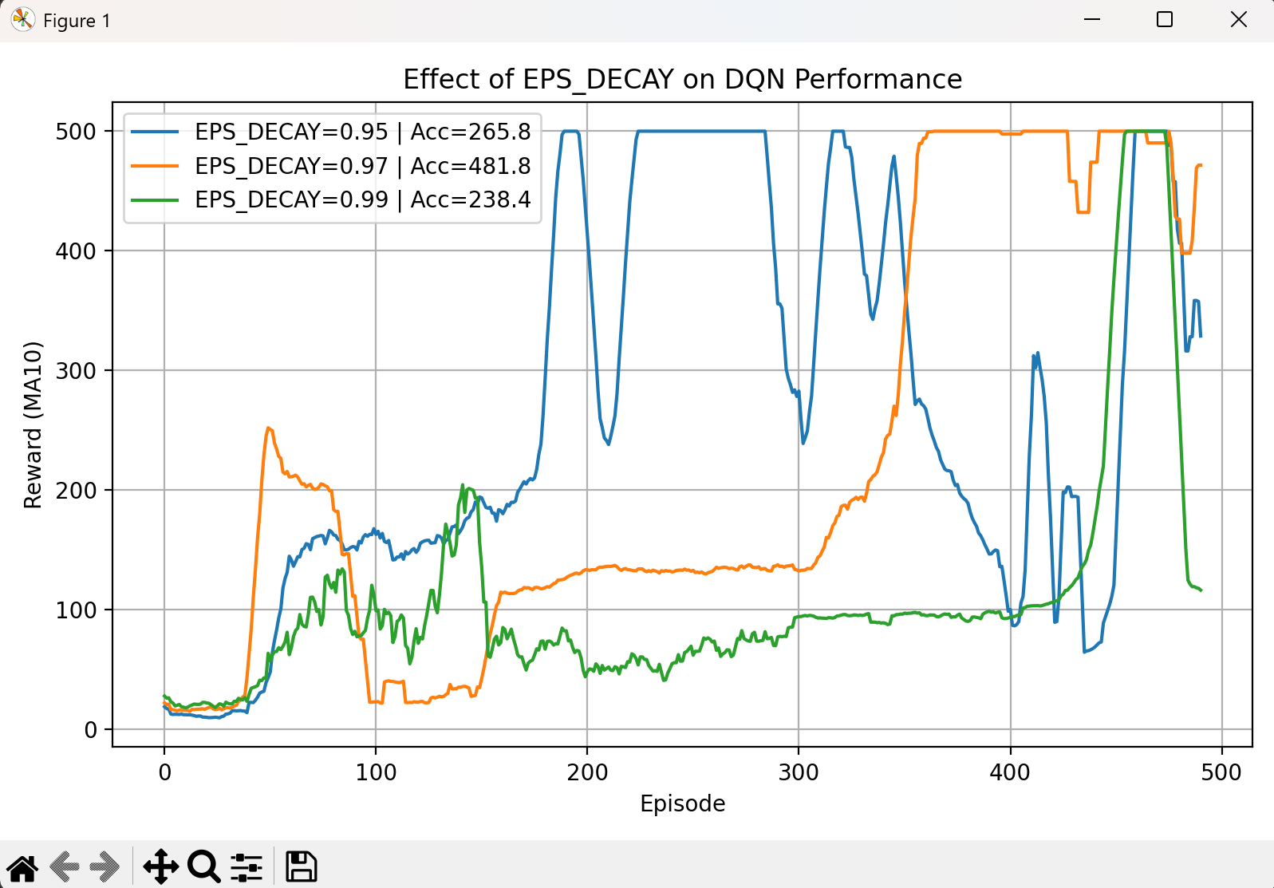
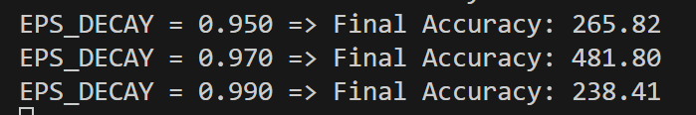
Hyperparameter selection
EPS_DECAY (ε decay rate)
Reason for choosing the value
Experimental objective
Summary for choosing EPS_DECAY = 0.97

Slide 16
Thank you ! Q&A

